Slide 1


Bank Loan Case Study
By, Pranav Jadhav
video presentation
excel link

Slide 2
1 | Project description
2 | Tech Stack Used
3 | Approach
4 | Analysis
5 | Insights
Table of Content

Slide 3

Project Description
The project is about finding out patterns that indicate if a customer will have difficulty paying their installments. This information can be used to make decisions such as denying the loan, reducing the amount of loan, or lending at a higher interest rate to risky applicants.

Slide 4


Tech Stack Used
Microsoft Excel 2016
&
canva (for presentation)

Slide 5

Approach
For this project I have used Microsoft Excel 2016,
The approach to this project involves using Excel to clean, manipulate and analyze the dataset. Various formulas were applied to perform data cleaning, create new columns, alter data based on specific criteria, group data, and generate visualizations. By analizing excel tables, the project can effeciently handle large datasets and extract relevant information from the given data.

Slide 6
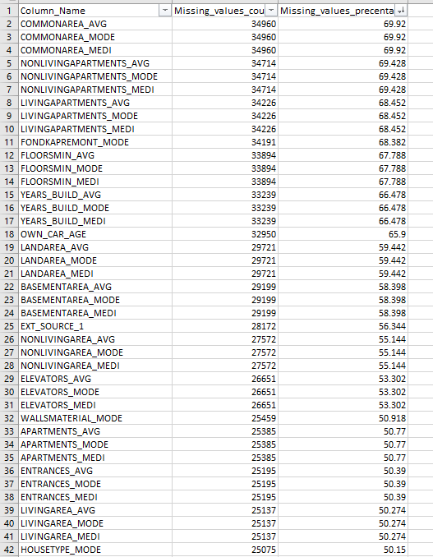
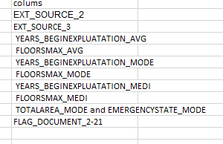
Missing Values
Application_data
These are the columns which have more than 50% of the data missing, So these columns need to be dropped from the table.
These are the columns which we need to remove as these columns have irrelevant data for analysis

Slide 7
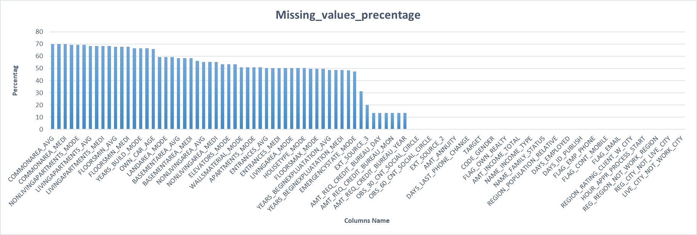
Missing Values

Slide 8
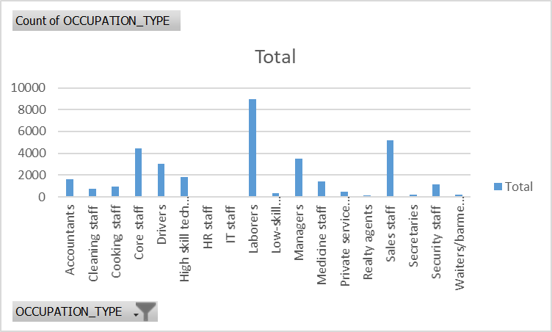
Missing Values
Imputation :- Mode
OCCUPATION_TYPE
Most occuring Category was “Laborers”. But we need to replace the null values with “Not mentioned” as there could be chances that it has been deliberately missed.

Slide 9
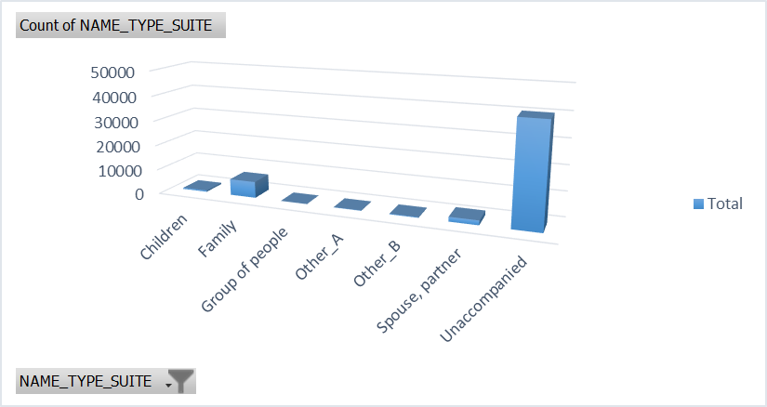
Missing Values
Imputation :- Mode
2. NAME_TYPE_SUITE
Most frequent categorie was “Unaccompanied” so we replaced all the missing values in the NAME_TYPE_SUITE column with it.

Slide 10
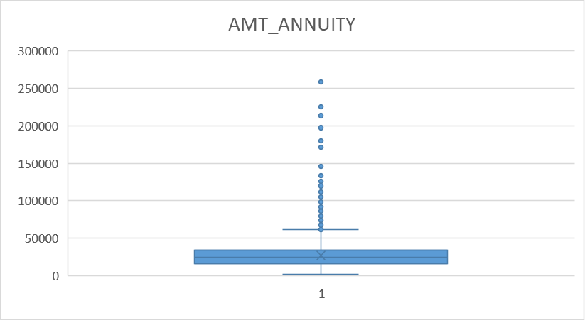
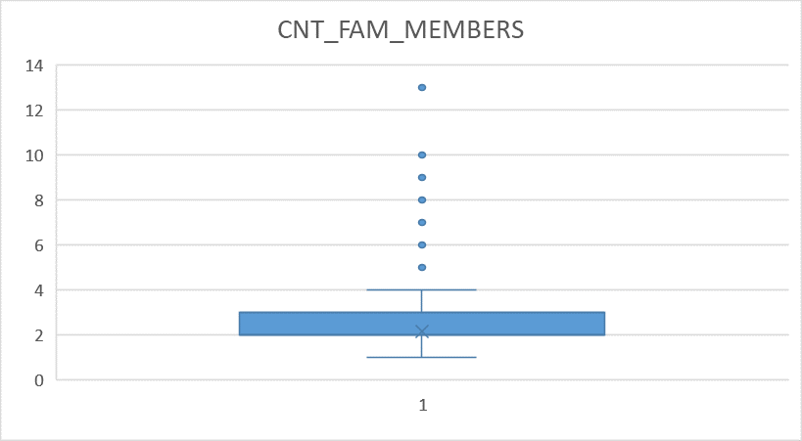
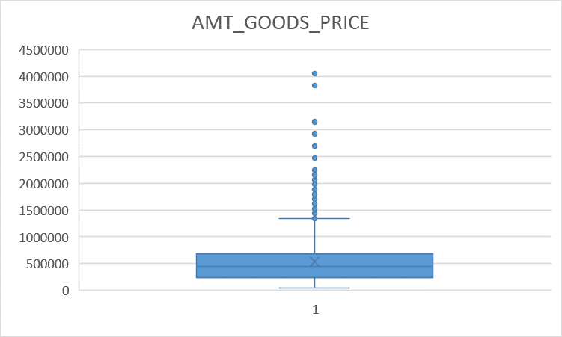
Missing Values
Imputation :- Median
We do have Outliers in the these columns so we will replace null values of the columns with the median values of each column.

Slide 11
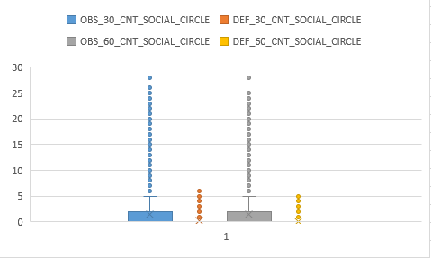
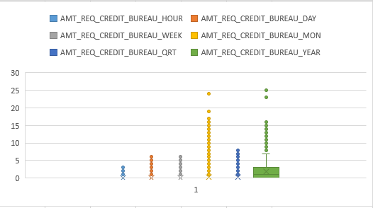
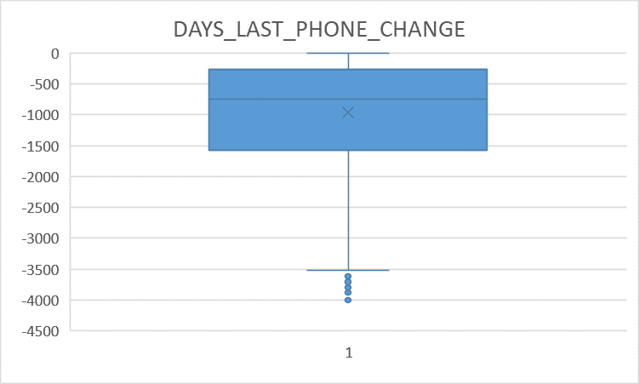
Missing Values
Imputation :- Median
We do have Outliers in the these columns so we will replace null values of the columns with the median values of each column.

Slide 12
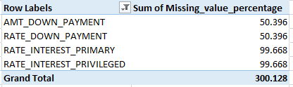
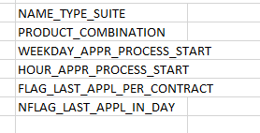
Missing Values
Previous_application_data
These are the columns which have more than 50% of the data missing, So these columns need to be dropped from the table.
These are the columns which we need to remove as these columns have irrelevant data for analysis

Slide 13
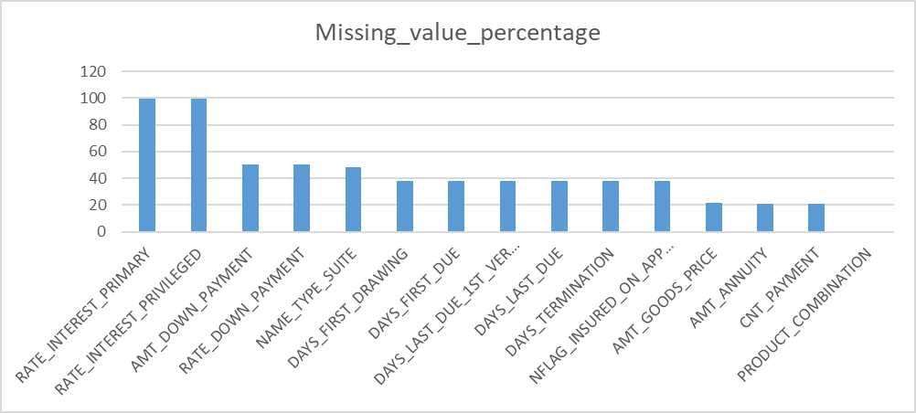
Missing Values

Slide 14
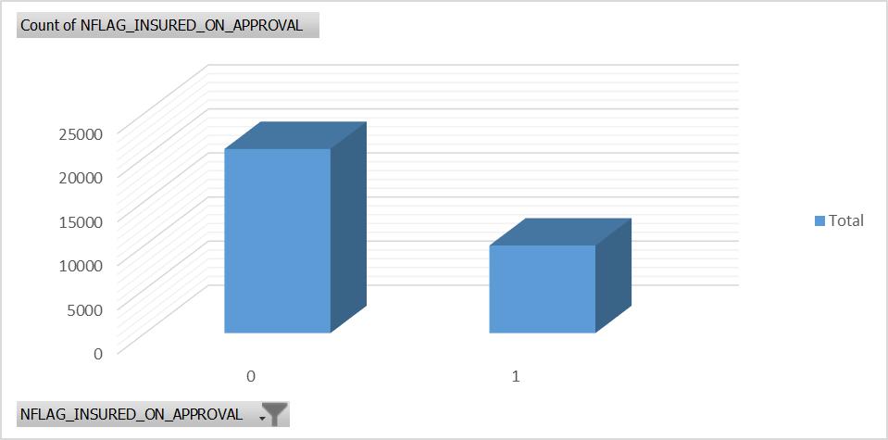
Missing Values
Imputation :- Mode
NFLAG_INSURED_ON_APPROVAL
Most occuring Category is “0”. So we will replace all the null values from the NFLAG_INSURED_ON_APPROVAL columns with 0.

Slide 15
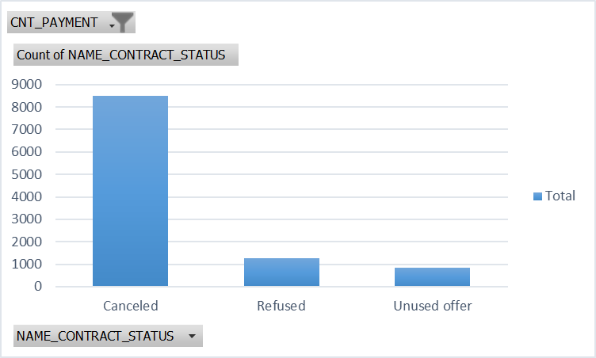
Missing Values
Imputation :- custom
CNT_PAYMENT
we do have outliers in the CNT_PAYMENT column as well but, the blank cells in the columns corresponds to the values “Canceled”, “Refused”, “Unused offer” in NAME_CONTRACT_STATUS column so its better to fill the null values with the 0.

Slide 16
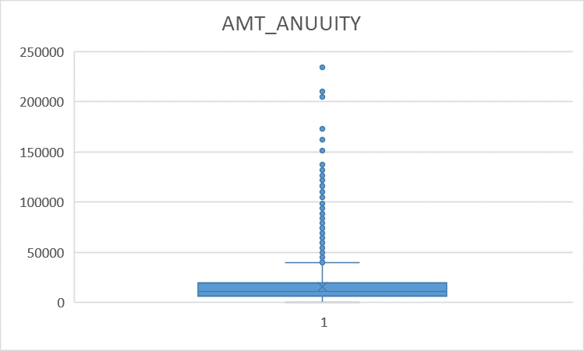
Missing Values
Imputation :- Median
AMT_ANNUITY
We replaced the null values with the Median of the AMT_ANNUITY column due to presence of the outliers in the column

Slide 17
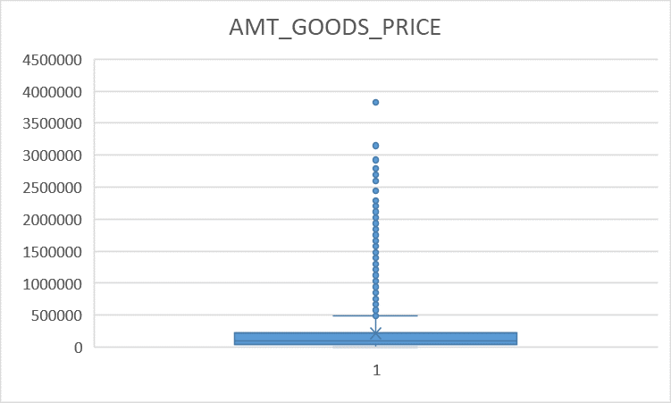
Missing Values
Imputation :- Median
2. AMT_GOODS_PRICE
We replaced the null values with the Median of the AMT_GOODS_PRICE column due to presence of the outliers in the column

Slide 18
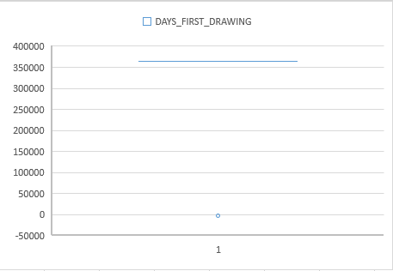
Missing Values
Imputation :- Median
3. DAYS_FIRST_DRAWING
We replaced the null values with the Median of the DAYS_FIRST_DRAWING column due to presence of the outlier in the column

Slide 19
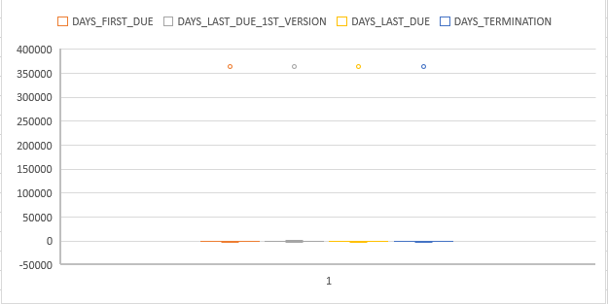
Missing Values
Imputation :- Median
3. DAYS_FIRST_DUE
4. DAYS_LAST_DUE_1ST_VERSION
5. DAYS_LAST_USE
6. DAYS_TERMINATION
We replaced the null values for each column with the Median of the each column due to presence of the outliers in the column

Slide 20
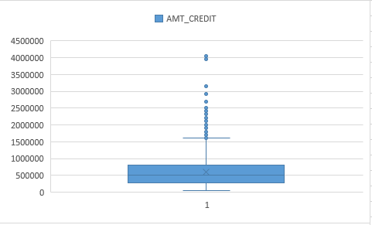
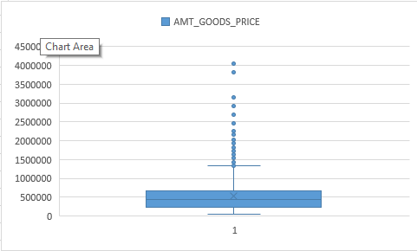
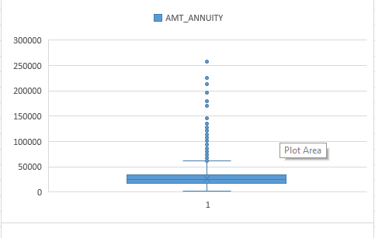
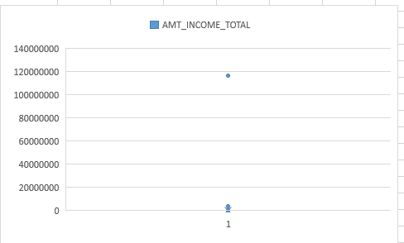
Outliers
We do have outliers in AMT_GOOD_PRICE, AMT_CREDIT, AMT_ANNUITY, AMT_INCOME_TOTAL, DAYS_BIRTH columns but they may vary person to person so we wont touch these outliers and keep them as it is.

Slide 21
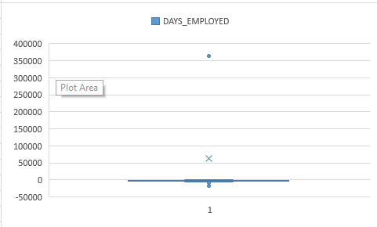
Outliers
We have a condition where DAYS_EMPLOYED has a value of 365243 which is impossible so will change it with the median value

Slide 22
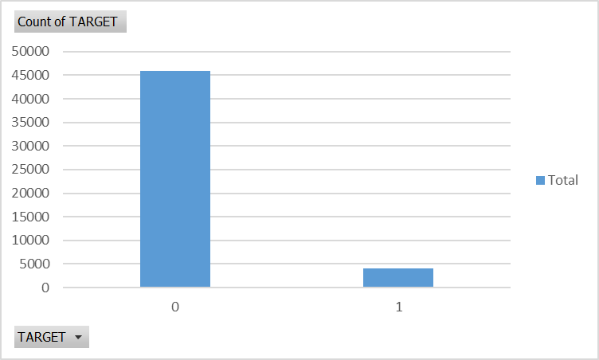
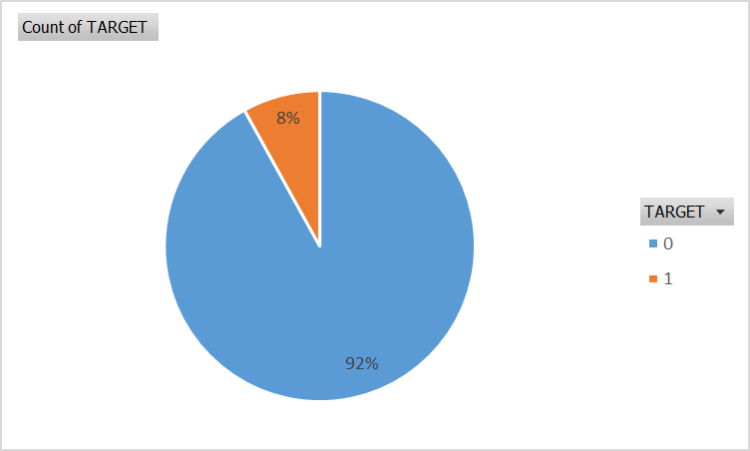
Data Imbalance
We have data Imbalance where we have count of defaulters (client with payment difficulties) less than the count of not defaulters (clients without payment difficulties), we have just 8% of defaulters and 92% of Not defaulters in the dataset.
Row Labels | Count of TARGET
0 | 45973
1 | 4026
Grand Total | 49999

Slide 23
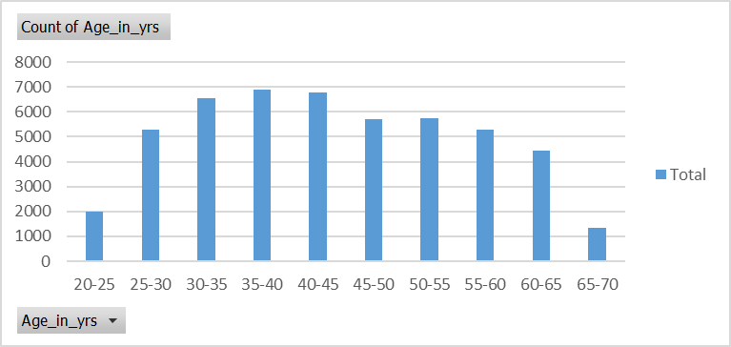
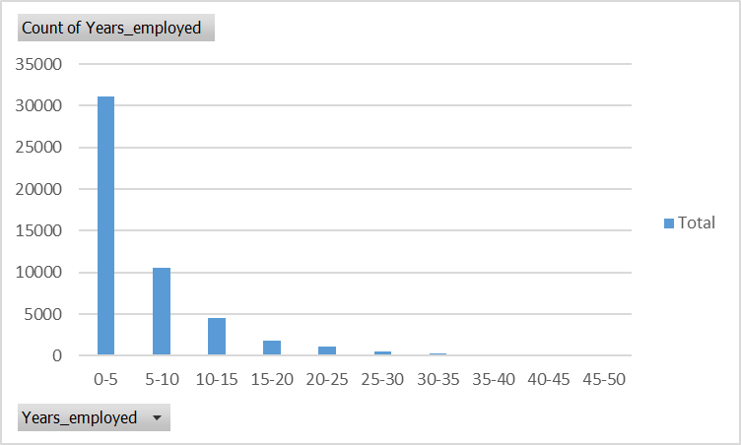
Univariate Analysis
AGE DISTRIBUTION
We do have Maximum clients from age group of 25- 65 yrs of age, with most clients in age group of 35 - 45 yrs of age.
YEARS_ EMPLOYED
We do have Maximum clients who has an experience of 0-10 yrs.

Slide 24
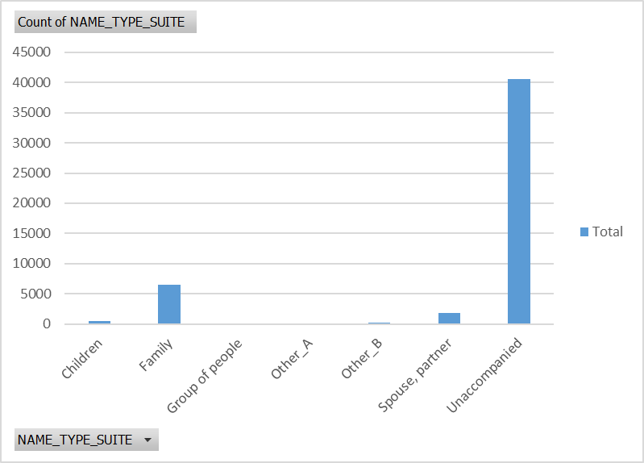
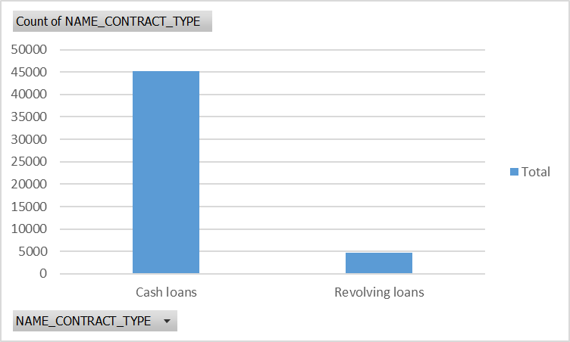
Univariate Analysis
NAME_TYPE_SUITE
Most of the clients were Unaccompanied during the process of the application.
NAME_CONTRACT_TYPE
Most of the clients have a cash loans contract with the bank.

Slide 25
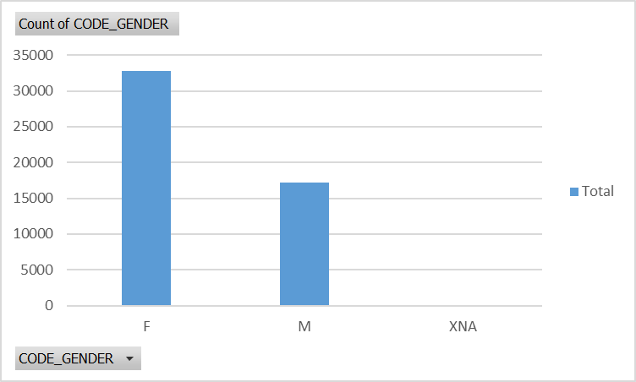
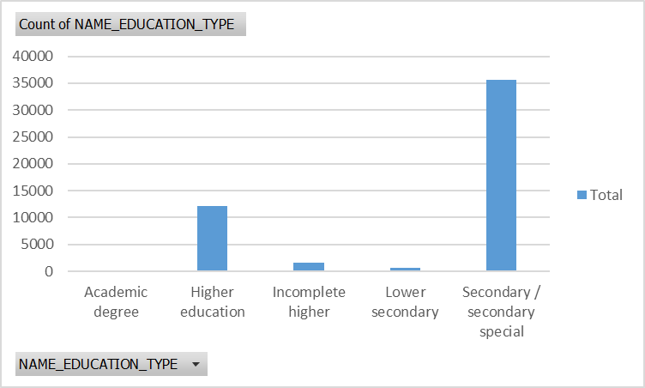
Univariate Analysis
GENDER
Most of the clients are female .
EDUCATION_TYPE
Most of the clients have the education qualification of Secondary/secondary special.

Slide 26
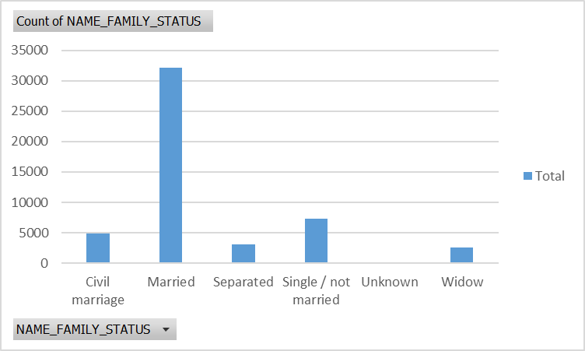
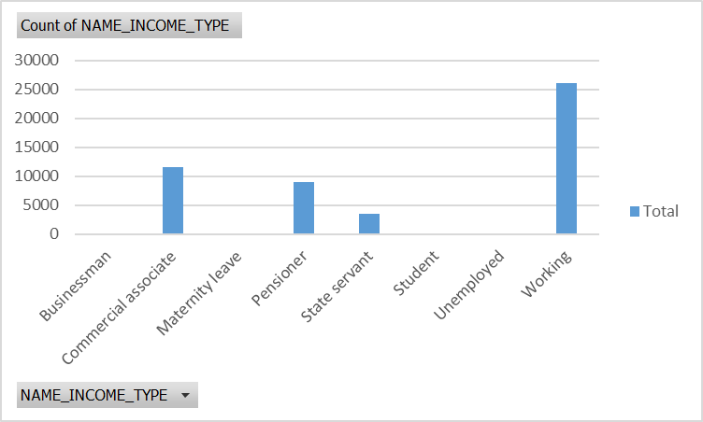
Univariate Analysis
FFAMILY STATUS
Most of the clients are Married.
IINCOME_TYPE
Bank have given the loan to the Working clients most.

Slide 27
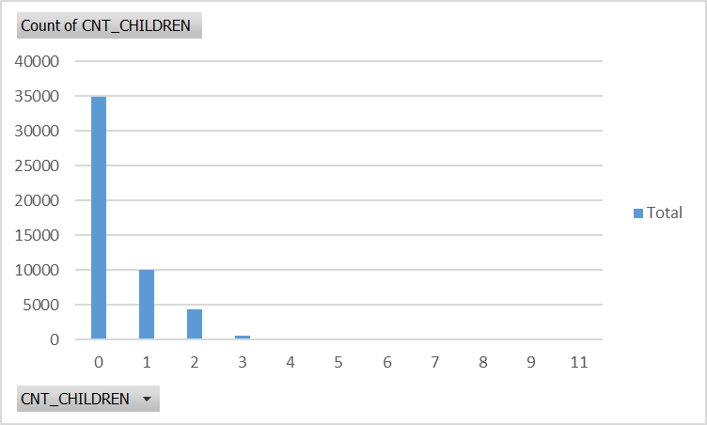
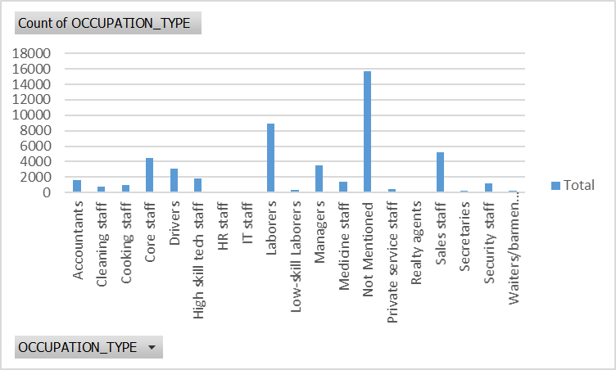
Univariate Analysis
COUNT_OF_CHILDRENS
There have being most of the instance where bank has lend loan to clients having no child.
OCCUPATION_TYPE
Most of the clients haven’t mentioned about their occupation to the bank.

Slide 28
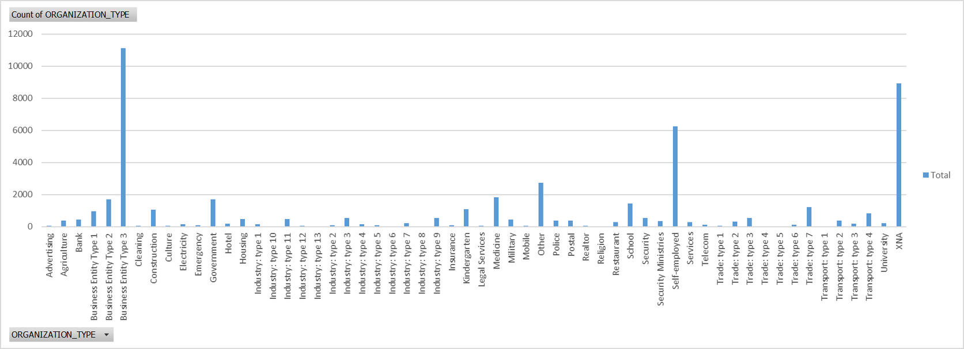
Univariate Analysis
ORGANIZATION_TYPE
most of the Clients work for the organization type of Business Entity Type 3.

Slide 29
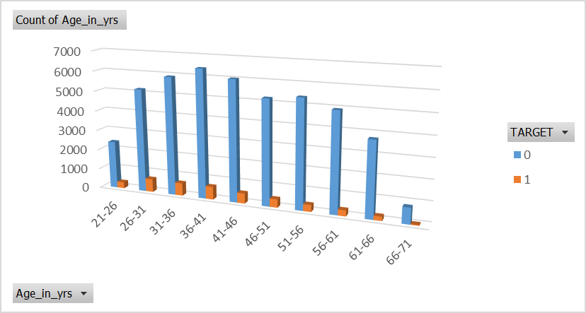
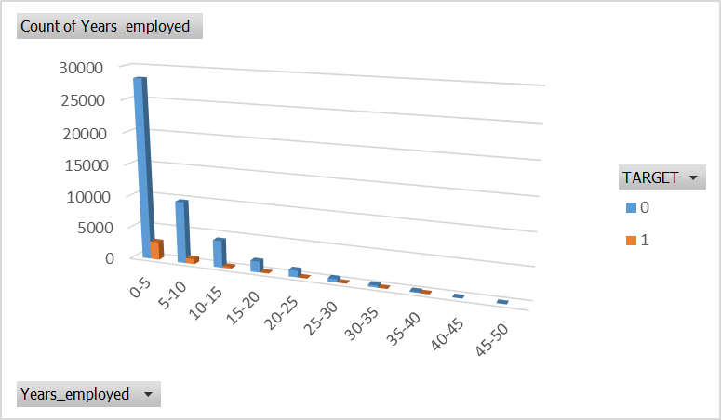
Segmented Univariate Analysis
AGE_IN_YRS
From the graph we can see that age group of 26-51 have problems in payments.
YEARS_EMPLOYED
The clients having experience of 0-10 have shown the problems in payments.

Slide 30
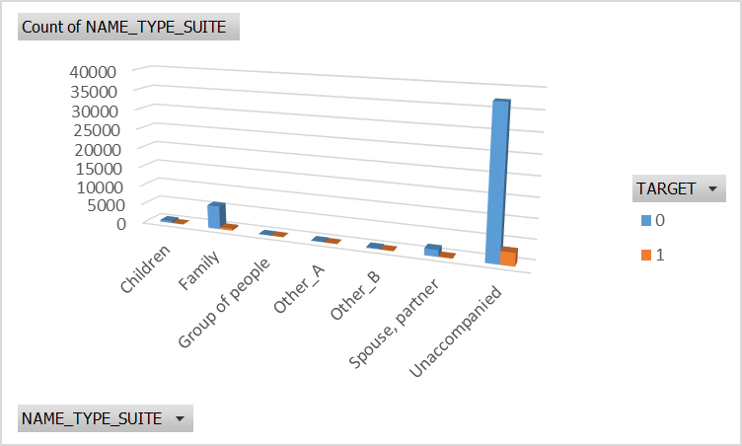
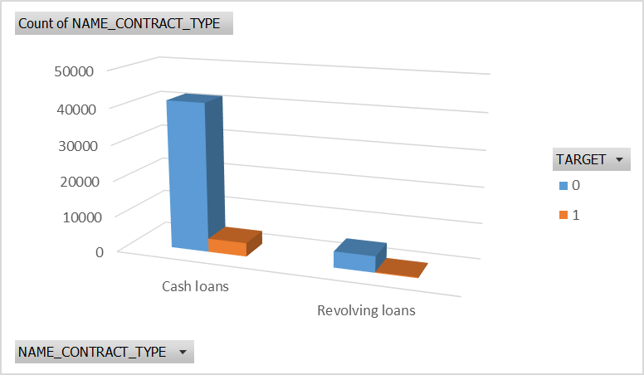
Segmented Univariate Analysis
NAME_TYPE_SUITE
The people who came Unaccompanied have most possibility of having problems in payments
NAME_CONTRACT_TYPE
Most of the clients have choose the Cashloans as the contract type so we do have most number of clients having problems in payment in Cash Loans type of contract.

Slide 31
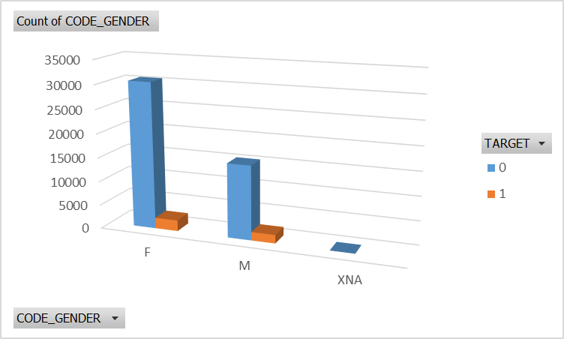
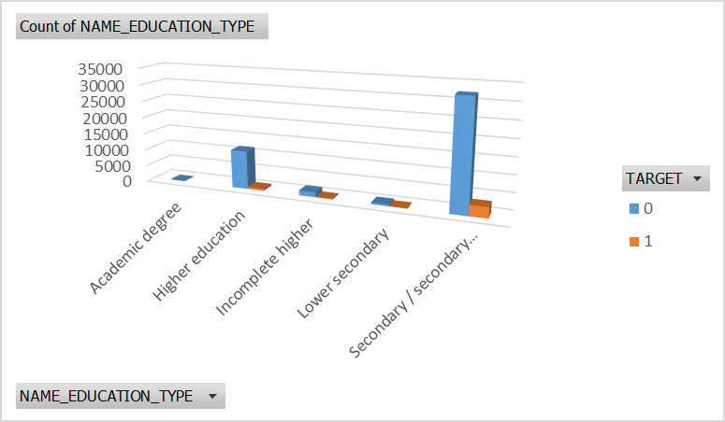
Segmented Univariate Analysis
CODE_GENDER
Though it looks similar we do have proportion of males having difficulty in payments more than that of Females.
NAME_EDUCATION_TYPE
Seconday/secondary special are the education of the clients who have taken loan from the bank and also have the most number of clients having difficulty in payments.

Slide 32
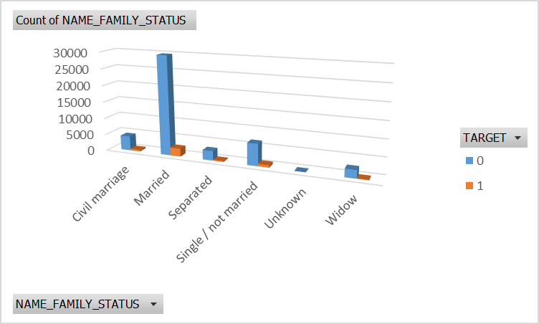
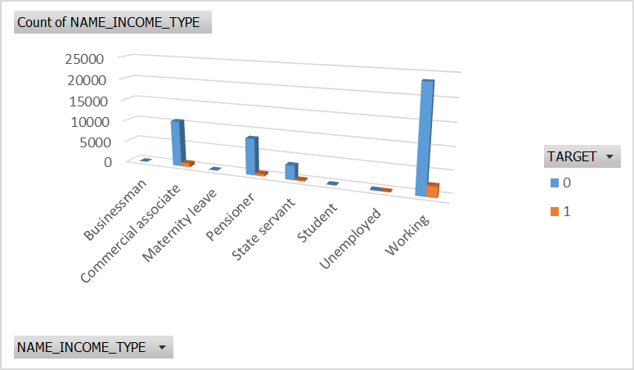
Segmented Univariate Analysis
FAMILY_STATUS
We do have the most number of clients who are married and also they have the most number for the whether they have difficulty in payments.
NAME_INCOME_TYPE
Most of the clients are working professinals and also they have the difficulties in the payments.

Slide 33
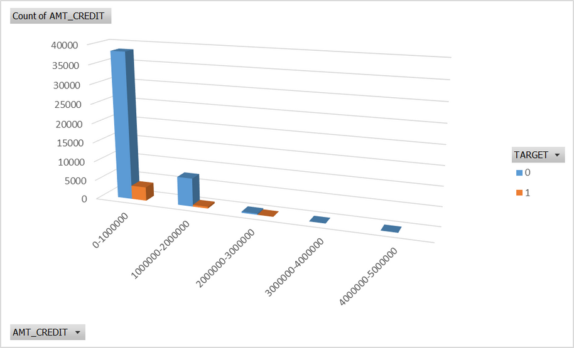
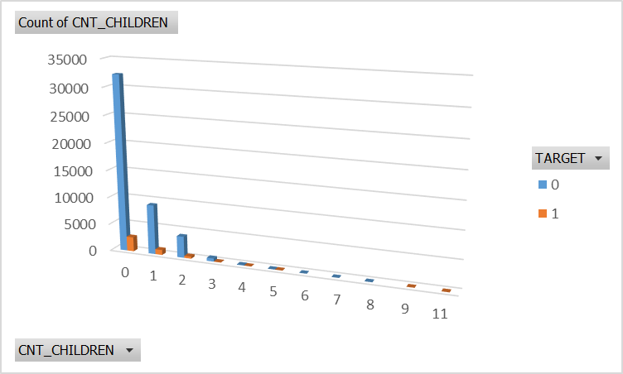
Segmented Univariate Analysis
AMT_CREDITED
We do have the clients who have been credited an amount between 0-10,00,000 and have most number of defaulters as well.
CNT_CHILDREN
The clients having no child are the most and also most in the defaulters.

Slide 34
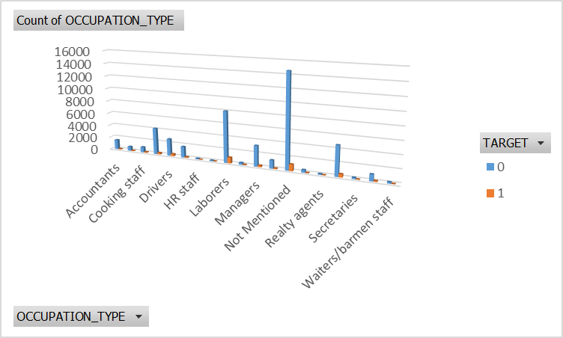
Segmented Univariate Analysis
OCCUPATION_TYPE
We can see that clients who have not mentioned their Occupation had difficulties in the payments followed by Labours.

Slide 35
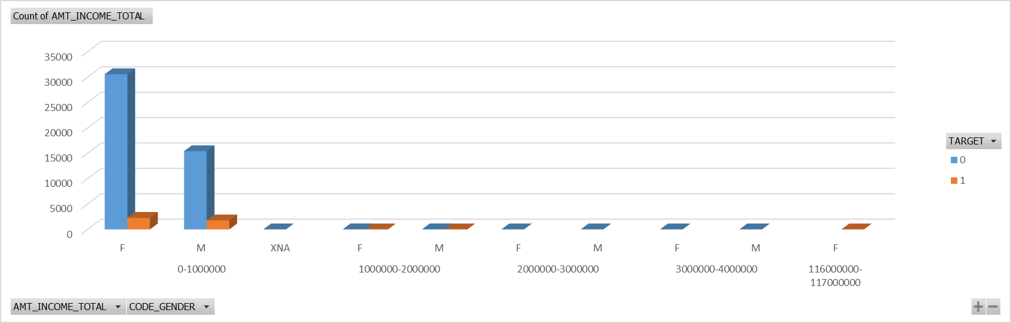
Bivariate Analysis
From below chart we can see that most of the clients are Females with income between 0-10,00,000 also they are more in number as a defaulters but if we look closely we can infer that males have highers proportion as defaulters than females looking at their count.

Slide 36

Bivariate Analysis
From chart below, we can infer that Age group 41-49 took the highest amount of loan but age group 50-59 are defaulter with highest amount of loan.

Slide 37

Bivariate Analysis
From the below graph we can infer that Businessman took the highest amount of loan and did the payment on time. Clients who are unemployed have highest amount of loan which they didn’t repay on time.

Slide 38

Bivariate Analysis
From the below graph we can infer that clients having qualification as secondary/secondary special and have taken loan between 0-10,00,000 are the most also they had difficulties in the payments.

Slide 39

Correlation between the tables
These visuals shows the correlation of the each column with the other columns in the dataset.

Slide 40

Insights
Most of the clients are loan repayers.
The bank generally lends more loan to the females, and the proportion of being a defaulter is less than that of males.
As age and experience increases the chances of being defaulter is increasing.
Educated clients tend to less defaulter compared to clients with lower education such as secondary special education so Bank should prefer clients with having such education status.
As number of children increases, number of client who take loan decreases.
The Bank should be more cautious when lending money to clients who are unemployed because they are the most defaulters with highest amount of credit

Slide 41
Thankyou.

